Slide 1
How does weather conditions affect dengue cases?
By Davian

Slide 2
Datasets
Historical1hrPM2.5.csv - https://beta.data.gov.sg/collections/1379/view
RainfallMonthlyTotal.csv - https://beta.data.gov.sg/collections/1399/view
RelativeHumidityMonthlyMean.csv - https://beta.data.gov.sg/collections/1404/view
SurfaceAirTemperatureMonthlyMean.csv - https://beta.data.gov.sg/collections/1419/view
WeeklyNumberofDengueandDengueHaemorrhagicFeverCases.csv - https://beta.data.gov.sg/collections/509/view

Slide 3
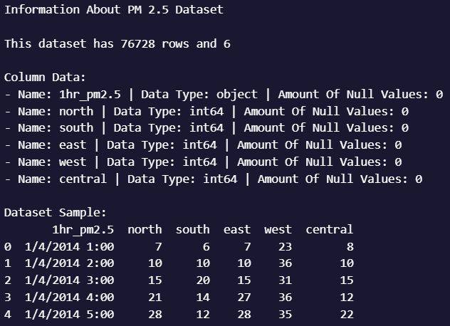
PM 2.5 Dataset Info
This dataset contains historical regional 1-hr PM2.5 value measured in µg/m3.

Slide 4
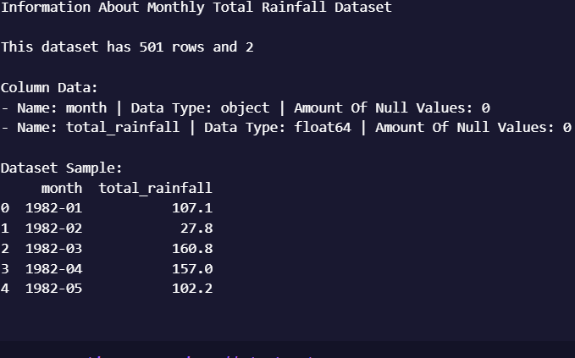
Total Monthly Rainfall Dataset Info
This dataset contains the total monthly rainfall recorded at the Changi Climate Station.

Slide 5
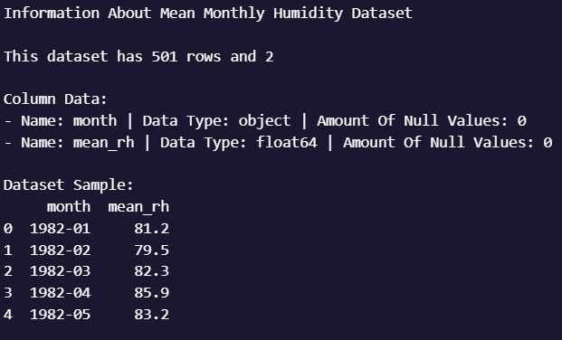
Monthly Mean Relative Humidity Dataset Info
This dataset contains the monthly mean relative humidity recorded at the Changi Climate Station.

Slide 6
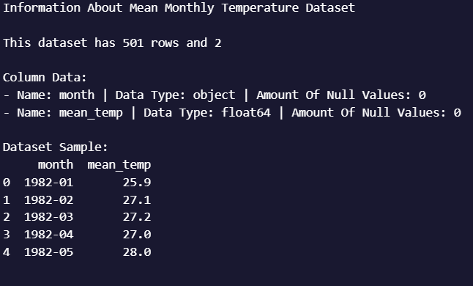
Monthly Mean Surface Air Temperature Dataset Info
This dataset contains the monthly mean air temperature recorded at the Changi Climate Station.

Slide 7
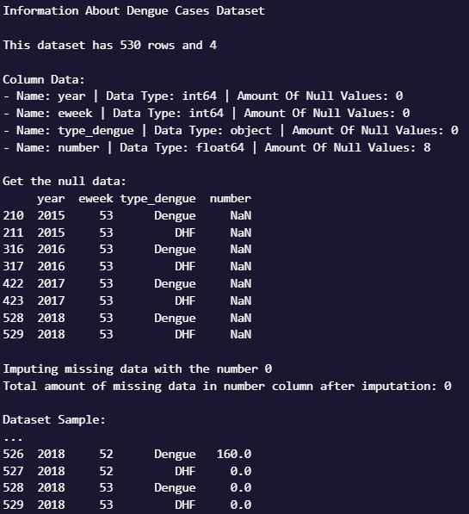
Number of Dengue Cases Dataset Info
This dataset contains the weekly number of lab-confirmed dengue and dengue haemorrhagic fever cases from 2014 to 2018.
This dataset has missing null values which was imputed with 0.

Slide 8
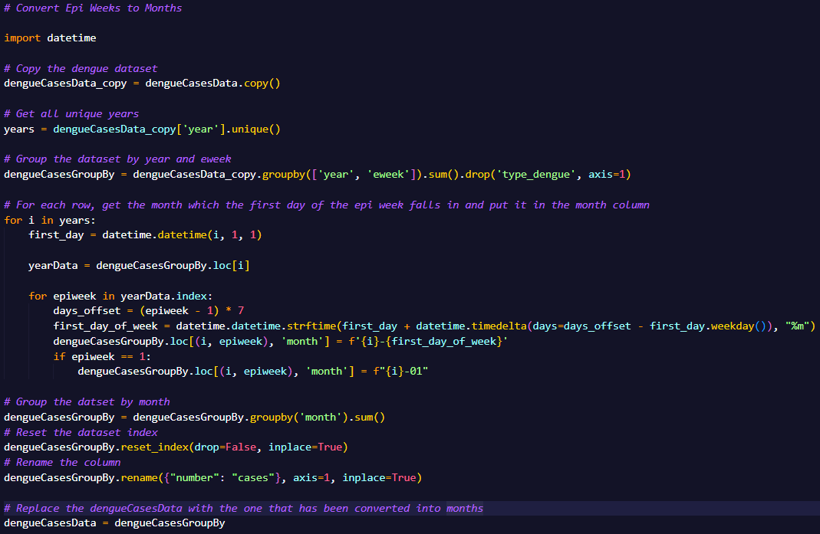
Number of Dengue Cases Dataset Info – Further Processing
As the dataset is in epiweeks, we have to convert it into month.
However, there is no accurate way to convert epiweeks into month due to a lack of data. Therefore, an estimation is necessary.
We can estimate it by giving each row the month of which the first day of the epi week falls in.

Slide 9
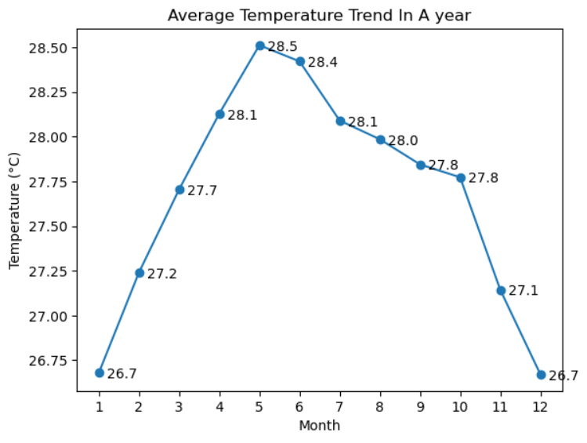
Average Temperature Trends In A Year

Slide 10
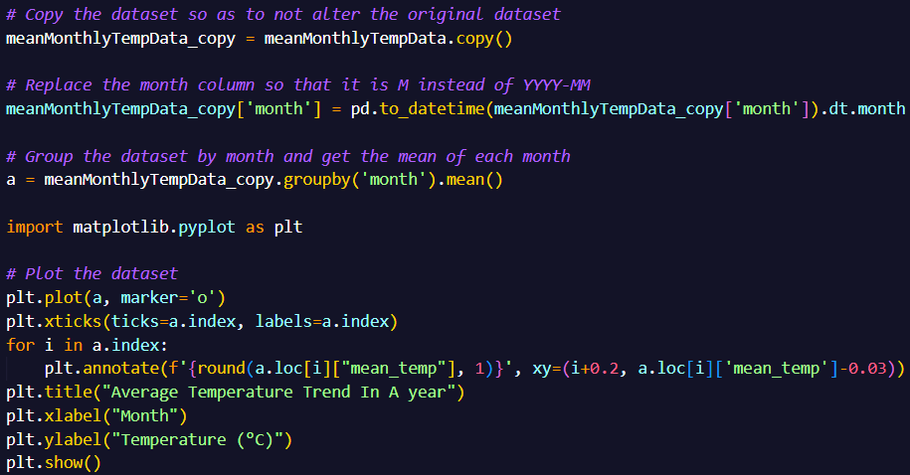
Average Temperature Trends In A Year – Pre-visualization Process
The Month column was converted into a datetime object after which I used Pandas to group the dataset by the Month Column and got the mean of each month.
After which, Matplotlib was used to visualise the data into a line graph.

Slide 11
Average Temperature Trends In A Year – Analysis
We can see that the temperature decreases near the last 3 months of the year to a low of 26.7°C in December and January before rising from January onwards to a high of 28.5°C in August

Slide 12
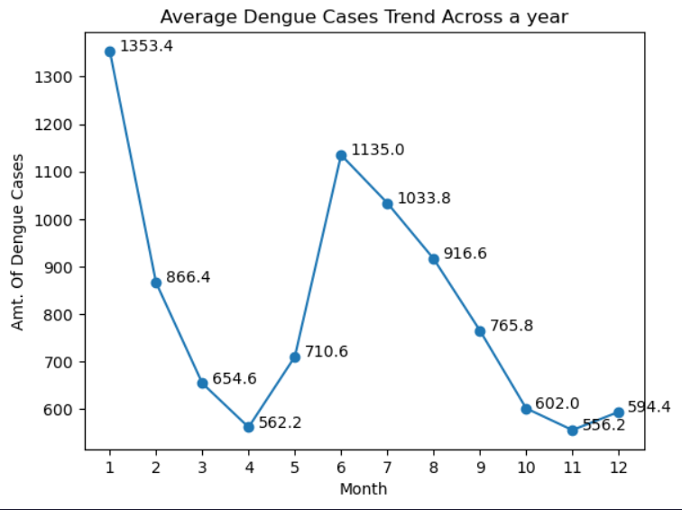
Average Dengue Cases Trend In A Year

Slide 13
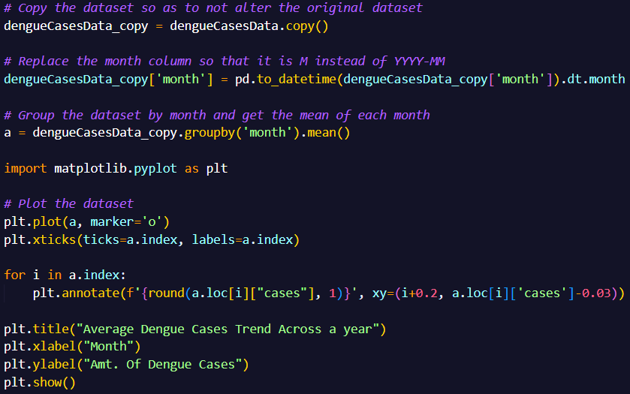
Average Dengue Cases Trend In A Year – Pre-visualization Process
The Month column was converted into a datetime object after which I used Pandas to group the dataset by the Month Column and got the mean of each month.
After which, Matplotlib was used to visualise the data into a line graph.

Slide 14
Average Dengue Cases Trend In A Year – Analysis
We can see that dengue cases decreases from January to April and from June to November to a low of 562.2 cases in April while dengue cases rise from April to June and from November to January to a high of 1353.4 cases in January

Slide 15
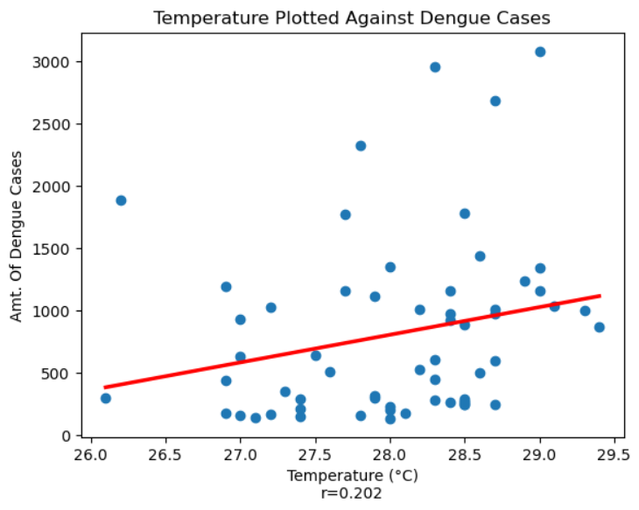
Temperature’s Relation With Dengue Cases

Slide 16
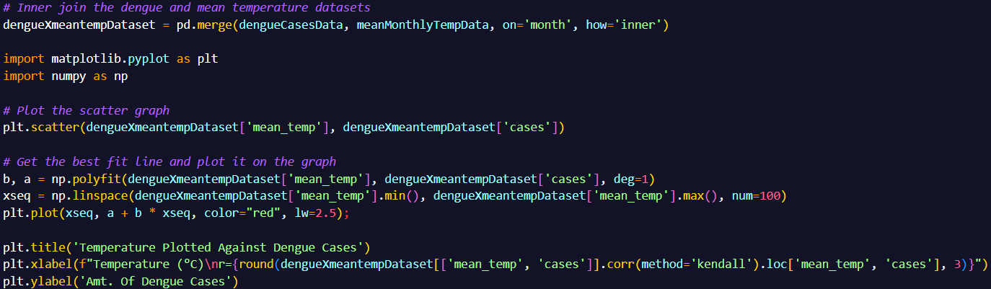
Temperature’s Relation With Dengue Cases – Pre-visualization Process
Merge the dengue and mean temperature dataset by using inner join on the year column. Plot the scatter graph. Get the best fit line and plot it on the graph. Calculate the r score and put it in the x label.

Slide 17
Temperature’s Relation With Dengue Cases – Analysis
As you can see, there is a weak positive relationship between Surface Air Temperature and Amount Of Dengue Cases.
This suggests that as the temperature increases, the amount of dengue cases increases too.

Slide 18
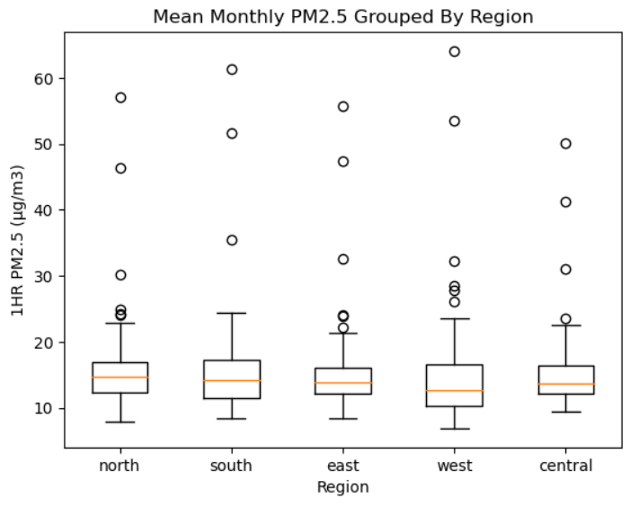
Distribution Of PM2.5 By Region

Slide 19
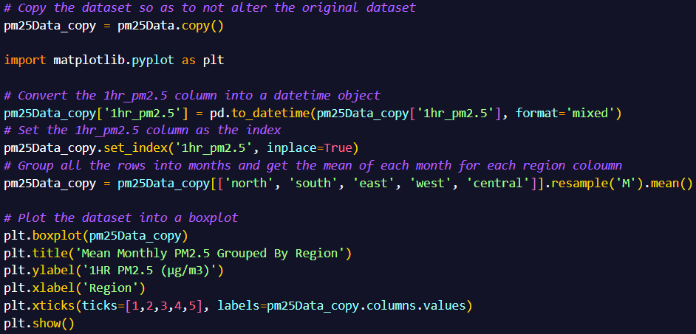
Distribution Of PM2.5 By Region - Pre-visualization Process
Copy the pm25 dataset just in case we have to use the original dataset for other uses. Convert the 1hr_pm2.5 column into a datetime object using the pd.todatetime function. Then set that column as the index
Then group all rows into months and get the mean of each month for each region column
Plot it onto a boxplot

Slide 20
Distribution Of PM2.5 By Region - Analysis
The PM2.5 distribution is quite uniform across all regions.
The interquartile range for all columns are in the healthy range.
There are times when the PM2.5 exceeds the healthy range but most of the time it doesn’t exceed the healthy range.

Slide 21
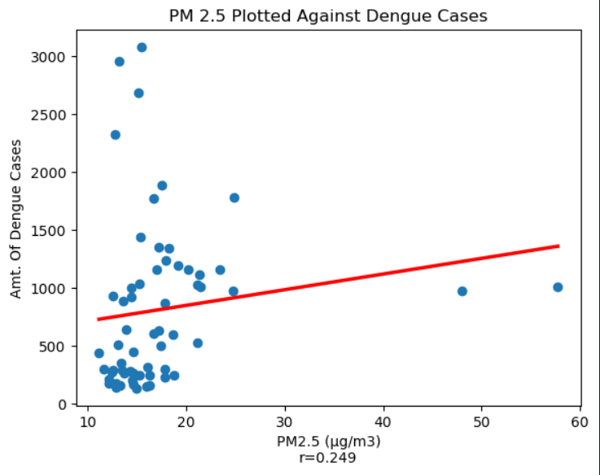
PM2.5’s Relationship With Dengue Cases

Slide 22
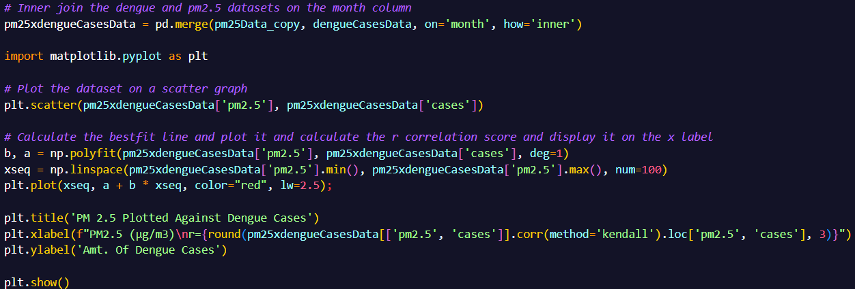
PM2.5’s Relationship With Dengue Cases - Pre-visualization Process
Merge the dengue and pm2.5 dataset by using inner join on the month column. Plot the scatter graph. Get the best fit line and plot it on the graph. Calculate the r score and put it in the x label.

Slide 23
PM2.5’s Relationship With Dengue Cases - Analysis
As you can see, there is a weak positive relationship between PM2.5 and Amount Of Dengue Cases.
This suggests that as PM2.5 increases, the amount of dengue cases increases too.
If the outliers were to be removed, the graph would suggest a stronger relationship between PM2.5 and amt of dengue cases

Slide 24
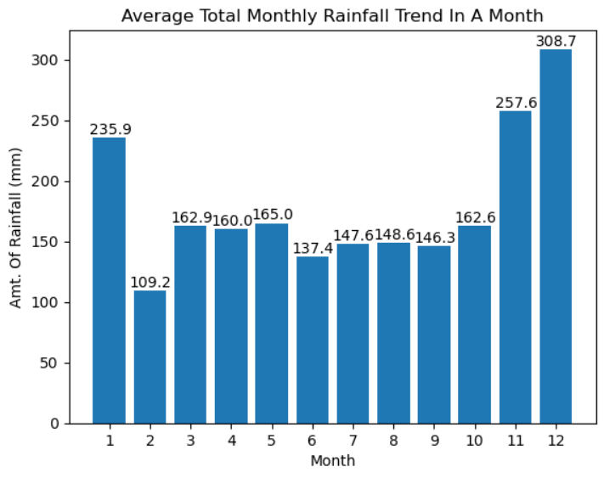
Average Monthly Rainfall Trend In A Year

Slide 25
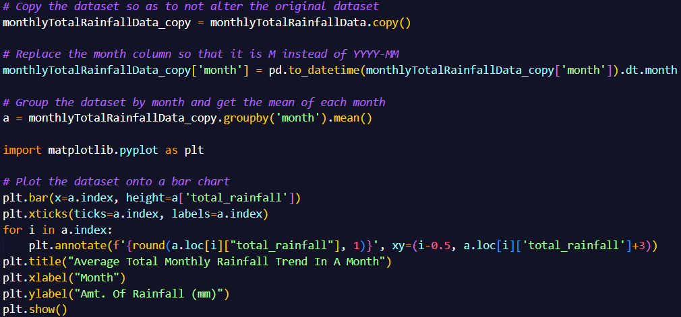
Average Monthly Rainfall Trend In A Year - Pre-visualization Process
The Month column was converted into a datetime object after which I used Pandas to group the dataset by the Month Column and got the mean of each month.
After which, Matplotlib was used to visualise the data onto a bar chart.

Slide 26
Average Monthly Rainfall Trend In A Year - Analysis
The monthly rainfall total increases at the end of the year from October to December to a high of 308.7mm in December before decreasing to a low of 109.2mm in February.
The monthly rainfall total remains nearly the same throughout the rest of the year between 137.4mm to 165.0mm

Slide 27
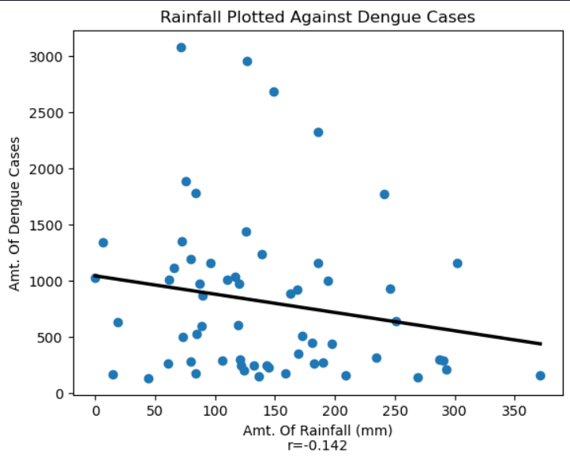
Rainfall’s Relationship With Dengue Cases

Slide 28
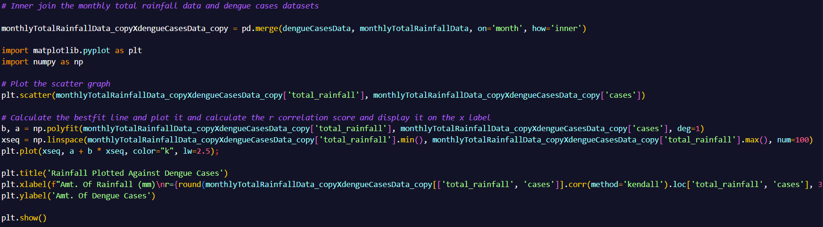
Rainfall’s Relationship With Dengue Cases - Pre-visualization Process
Merge the rainfall and pm2.5 dataset by using inner join on the month column. Plot the scatter graph. Get the best fit line and plot it on the graph. Calculate the r score and put it in the x label.

Slide 29
Rainfall’s Relationship With Dengue Cases - Analysis
The graph suggests a weak negative relationship between rainfall and amt of dengue cases
This is unexpected as it is normally thought that more rainfall would lead to more dengue cases due to increased breeding ground
With that said, rainfall and dengue cases have similar trends, peaking at nearly at same time as each other throughout the year.

Slide 31
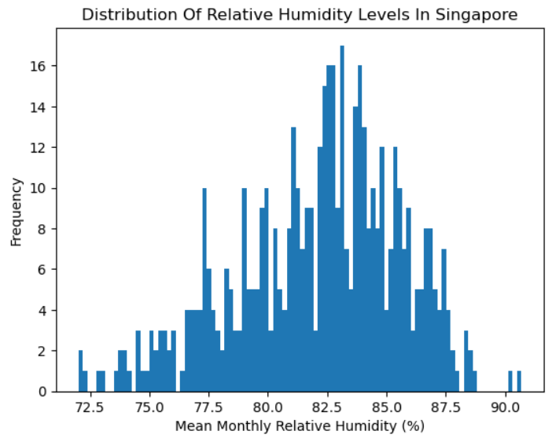
Distribution Of Humidity Levels

Slide 32
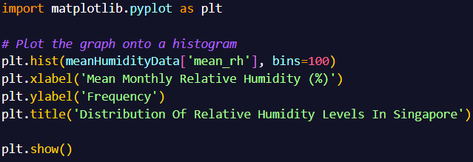
Distribution Of Humidity Levels - Pre-visualization Process
Not much preprocessing is needed for this.
Selected the necessary column and plot it onto a histogram with 100 bins.

Slide 33
Distribution Of Humidity Levels - Analysis
The distribution of humidity levels is negatively skewed.
The humidity levels mainly group around 77.5% to 87.5%
The most frequent humidity level is around 83.5%

Slide 34
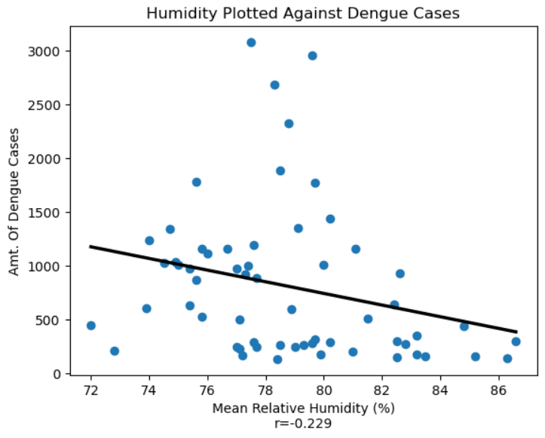
Humidity’s Relationship With Dengue Cases

Slide 35
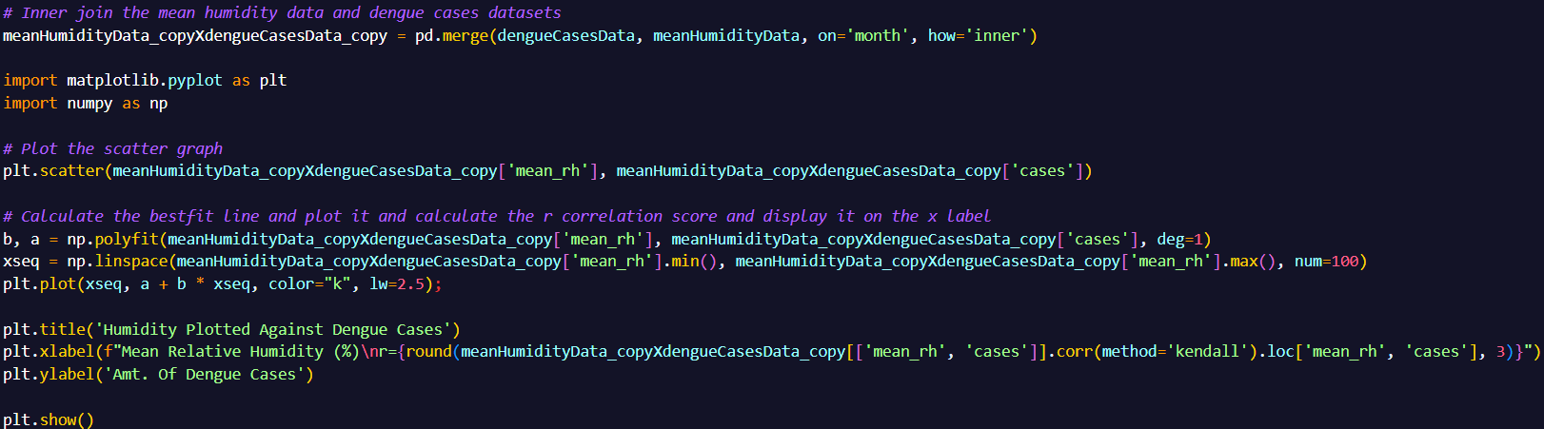
Humidity’s Relationship With Dengue Cases - Pre-visualization Process
Merge the humidity and dengue dataset by using inner join on the month column. Plot the scatter graph. Get the best fit line and plot it on the graph. Calculate the r score and put it in the x label.

Slide 36
Humidity’s Relationship With Dengue Cases - Analysis
As you can see, there is a weak negative relationship between Humidity levels and Amount Of Dengue Cases.
This suggests that as Humidity level increases, the amount of dengue cases decreases.

Slide 37
In Conclusion
From our insights, we can conclude that an increase in temperature and worser air quality leads to an increase in dengue cases.
However, an increase in rainfall and humidity levels leads to a decrease in dengue cases.

Slide 38
Thank you!
Any questions?

